Slide 1
Fraud detection at shopping malls using facial recognition
By
syed amair ali 160316733019
shaik abdul faraz 160316733024
mohd sohail ahmed 160316733031
b.E cse viii semester 2019 – 2020
Under the guidance of
Mrs. Neha unissa
Computer science department
Deccan collage of engineering & technology
Darussalam, nampally, hyderabad

Slide 2
intention
We intend to provide our product as service to different malls in our region.

Slide 3
Problem statement
Now-a-days, stealing, damaging the goods in the shopping malls become common.
This damage is done either knowingly or unknowingly.
This damage results in huge loss for the people who are running this businesses.

Slide 4
Appropriate solutions
There are two types of surveillance systems
Manual Surveillance System
Automated Surveillance System

Slide 5
What makes our product special
It requires only one image to train a model.
It can run on lower end systems as well.
It takes less time to train a model.
The product can recognise person with more than 90%.

Slide 6
issues
It can’t recognize the people’s face who wear masks or cover there faces.
While recognizing the people’s face who wear sun glasses, the accuracy is low.
It is very hard to identify the face or train the image when the face in the when picture is not clear enough.

Slide 7
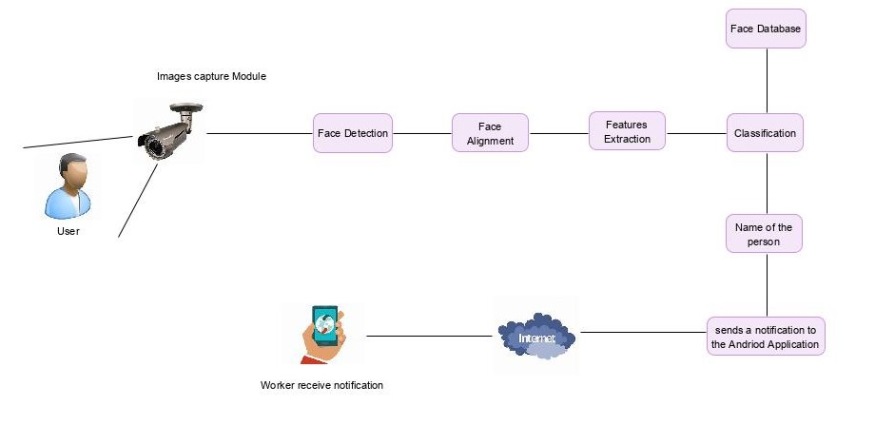
Proposed system architecture

Slide 8
Main actors
System Admin
Employee
Workers
Customers

Slide 9
Process
Face Recognition System architecture can perform following three tasks:
Acquisition/Face Detection (Face Detection, Tracking of faces)
Feature Extraction (Segmentation, Alignment & normalization of the face image)
Recognition

Slide 10

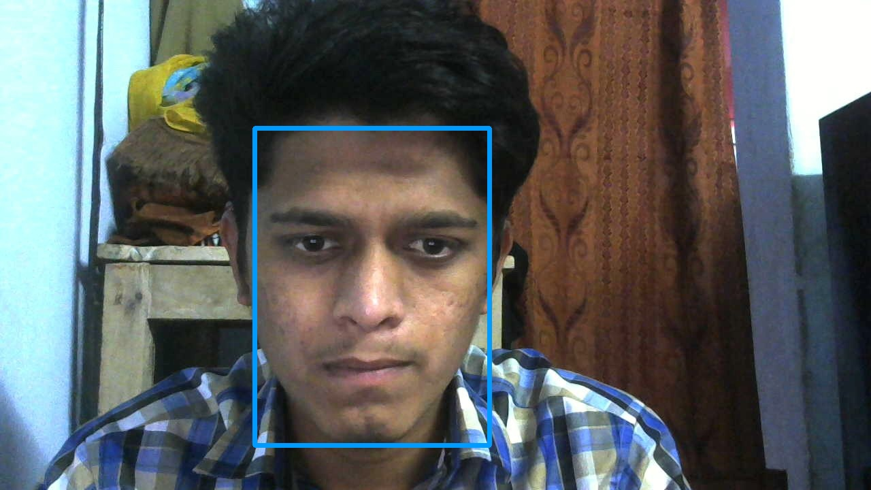
1) Face detection
It is a process of automatically identifying human faces.
After identification of face, it will show name of that person on the image or on a live video.

Slide 11

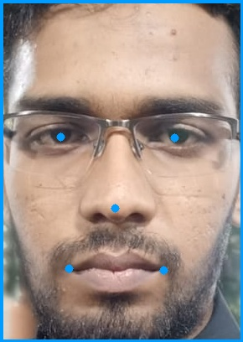
1) Face land marks detection
Once the face is detected, it search for landmarks of the face such as eyes, nose, lips, and many more.

Slide 12
2) Feature Extraction
It is a process of dimensionality reduction by which initial set of data is reduced into more manageable groups.
This approach is useful when data set is large and uses a lot of computing resources to process.
Feature extraction is the name for methods that select and /or combine variables into features, effectively reducing the amount of data that must be processed, while still accurately and completely describing the original data set.

Slide 13
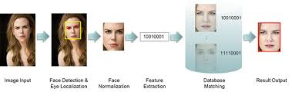
2) Feature Extraction

Slide 14
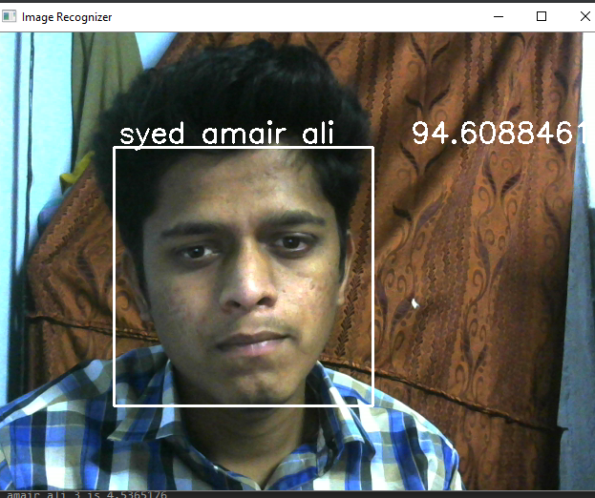
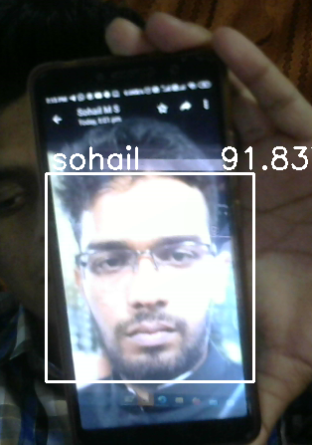
3) Face recognition
Face recognition is a technique which is used to identify a person.
This technique is used to identify people from photos, videos and from live streaming video as well.

Slide 15
ii. One shot learning
Because standard deep learning classifications required huge amount datasets to predict a person with high accuracy and the model has to be retrained for every new face, the solution is to use “ONE SHOT LEARNING”.
In this technique, the model is trained with fewer images.
It doesn't require to retrain the model, the same model is used for training new person’s face.
It can be implemented using the “Siamese Network” which has two identical fully connected CNN’s (Convolutional Neural Networks) with the same weights but accepts two different images.

Slide 16
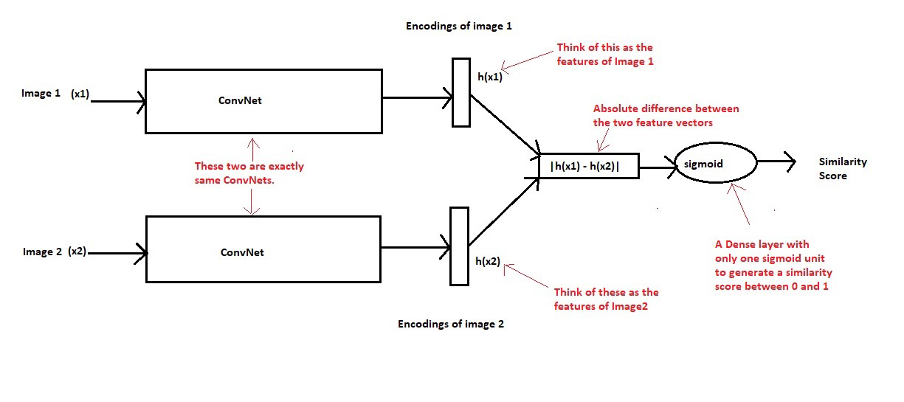
ii. One shot learning

Slide 17
iii. Transfer learning
Transfer learning is a machine learning technique, where a model trained for one task can be repurposed on a second related task.
Pre-trained models are used as the starting point to save on computational resources.
The form of transfer learning is used in deep learning is called inductive learning.

Slide 18
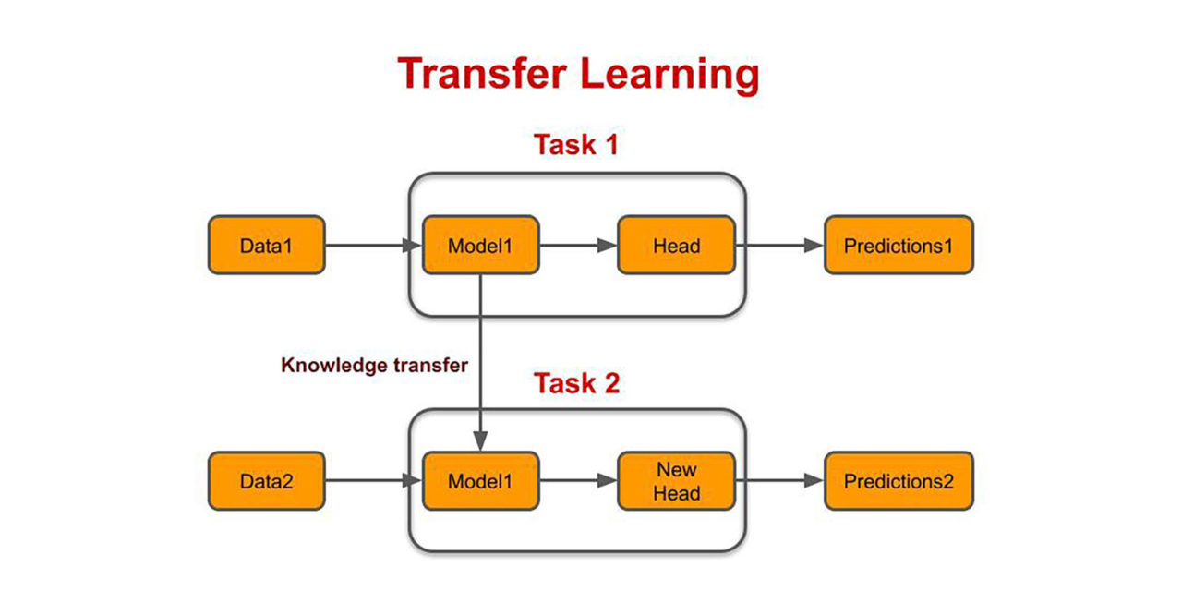
iii. Transfer learning

Slide 19
iv. Multi-task cascaded convolutional neural networks (mtcnn)
The MTCNN algorithm consists of three stages.
When the image is given as input, it will build an image pyramid and pass to stage 1.
In stage 1, the input image is scaled down multiple times and each scaled version of the image is passed to it’s CNN.
In stage 2, the images patches for each bounding boxes are extracted and then they are resized.
The resized images are then forwarded to their CNN’s.
In third stage, it computes five landmark points on face for each bounding box.

Slide 20
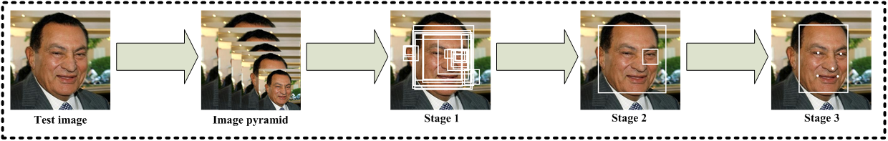
iv. Multi-task cascaded convolutional neural networks (mtcnn)

Slide 21
existing systems
Video surveillance system for real time detection of suspicious behaviours in shopping malls.
Video analytics solution for tracking customers locations in retail shopping malls.
Facial recognition at shopping centres.

Slide 22
Problem statement of existing system
Stealing, damaging the goods in the shopping malls becomes common.
Sometimes when no one is around, these people also steal goods.
Due to this issues, these businesses has to face huge losses.

Slide 23
H/w and s/w requirements
Hardware Requirement
Processor: Intel Dual Core
Cache: 256 KB Cache
Hard Disk: 40 GB Hard Disk
RAM: 1024 MB (1GB)
A Camera
Software Requirement
Operating System: Windows 8/10
Browser: Any Modern Browser
Android Mobile: Any Smart Phone That Run On Android
Internet Connection
Python 3.6.9 & Django 3.0.3

Slide 24
Proposed system
The existing system deals with face detection and face recognition.
Capture the face of a person and compare it with other faces which are present in database.
When face is matched, send notification on android application with necessary details.
Our software requires only single image of a person to train our model.

Slide 25
modules
Django Application Modules
Login
Sign Up
Home page
Train A Person’s Image
Show Existing Data
Send Push Notification On Android Devices88
Android Application Modules
Login
Sign Up
Forgot Password
Notification when the app is in background
Notification when the app is in foreground
Display data on home page from notification

Slide 26
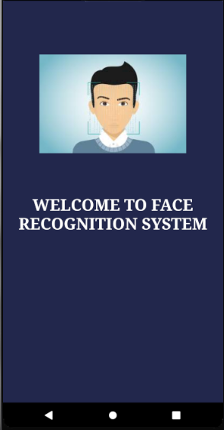
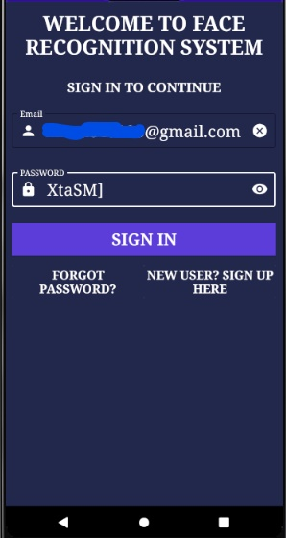
Android Application Modules
Android Welcome Screen
Android Login

Slide 27
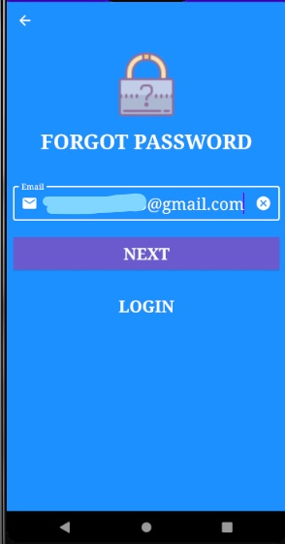
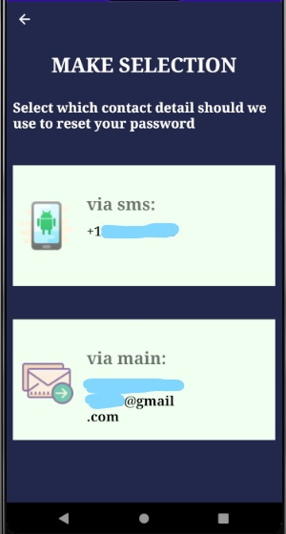
Android Application Modules
Forgot Password
Methods to send OTP to reset password

Slide 28
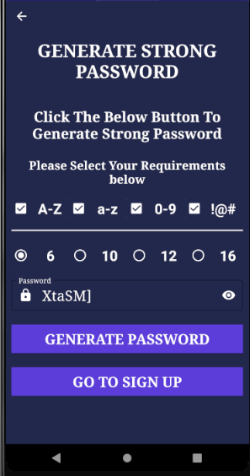
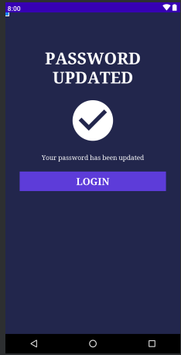
Generate New Password .Password Generated Successfully

Slide 29
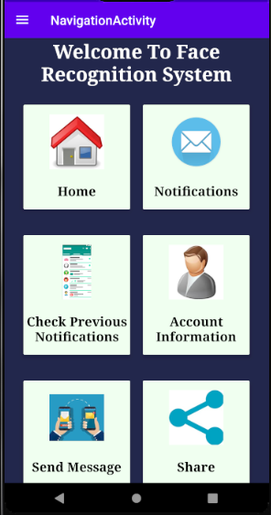
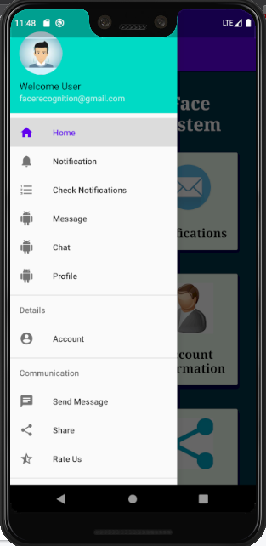
Home Screen for Worker
Navigation Shortcuts for Worker

Slide 30
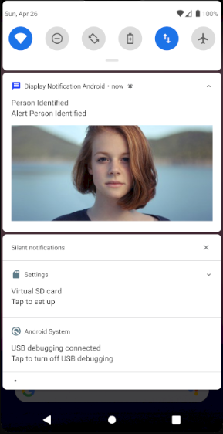
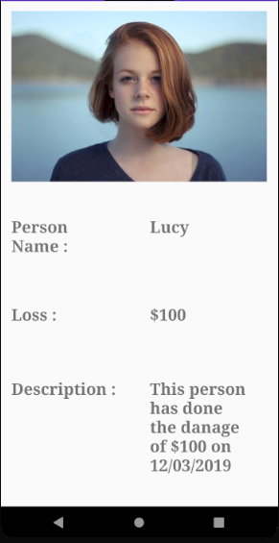
Android Application Modules
Android Notification
Display Notification Data

Slide 31
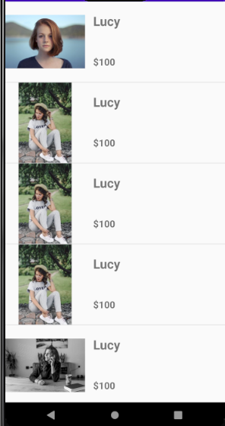
Recent Notification List

Slide 32
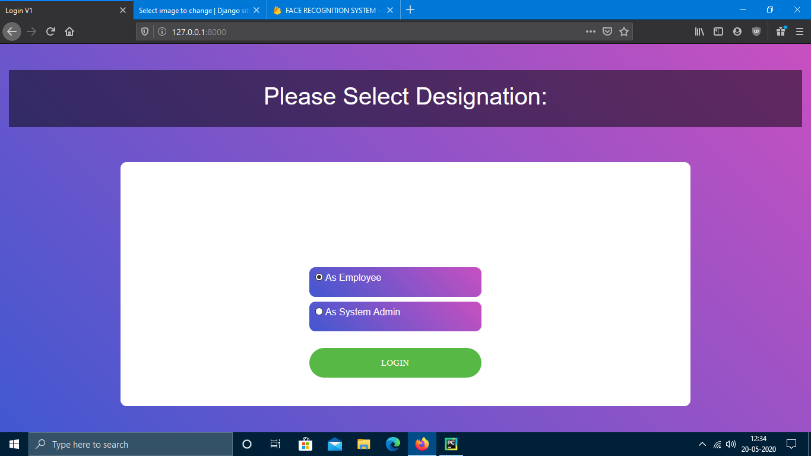
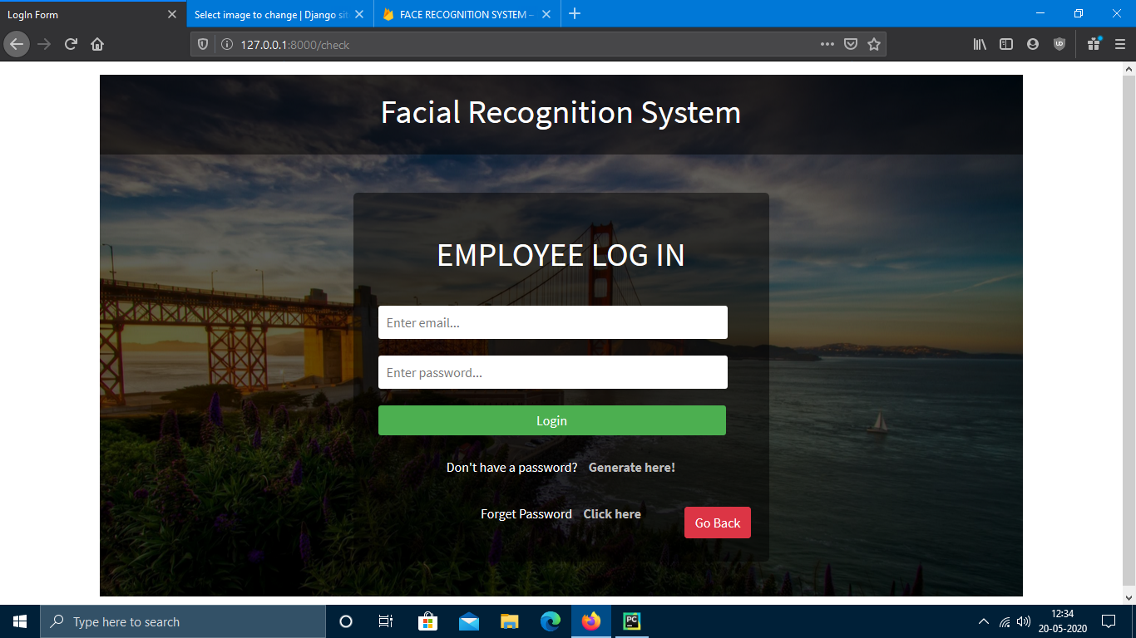
web application Modules
Application Login
Employee log in page

Slide 33
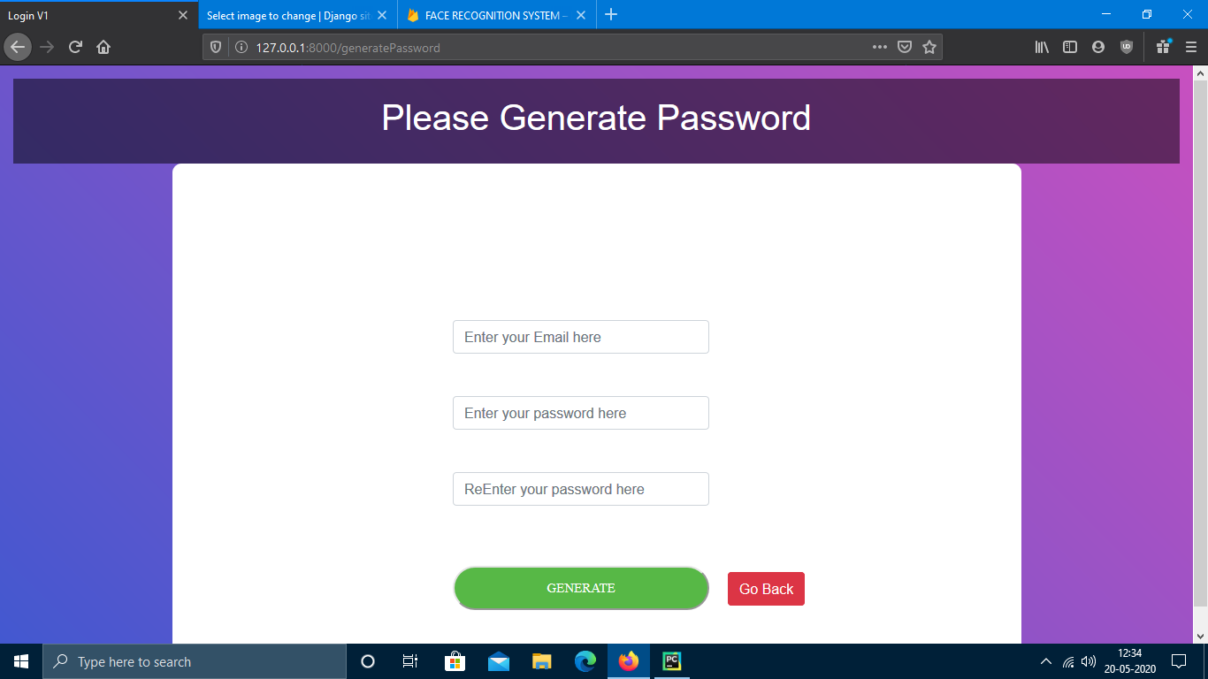
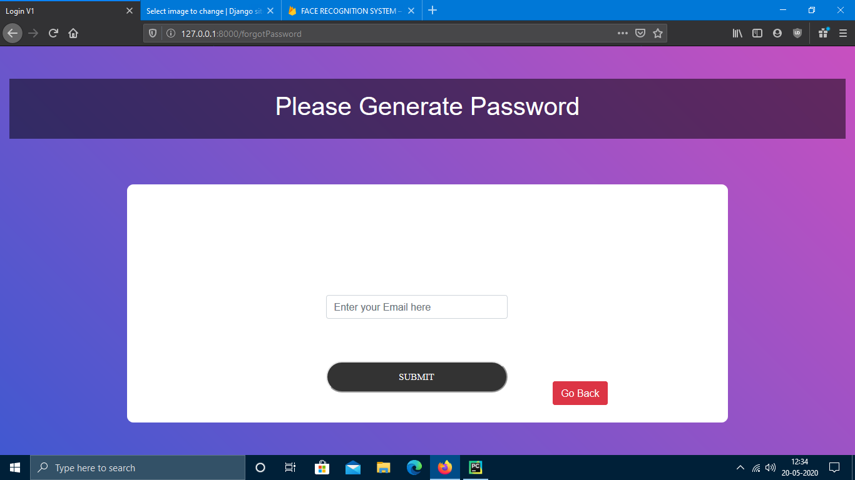
web application Modules
Password Generator for Employee
Forgot password page for Employee

Slide 34


Home page for Employee .Adding worker by Employee

Slide 35
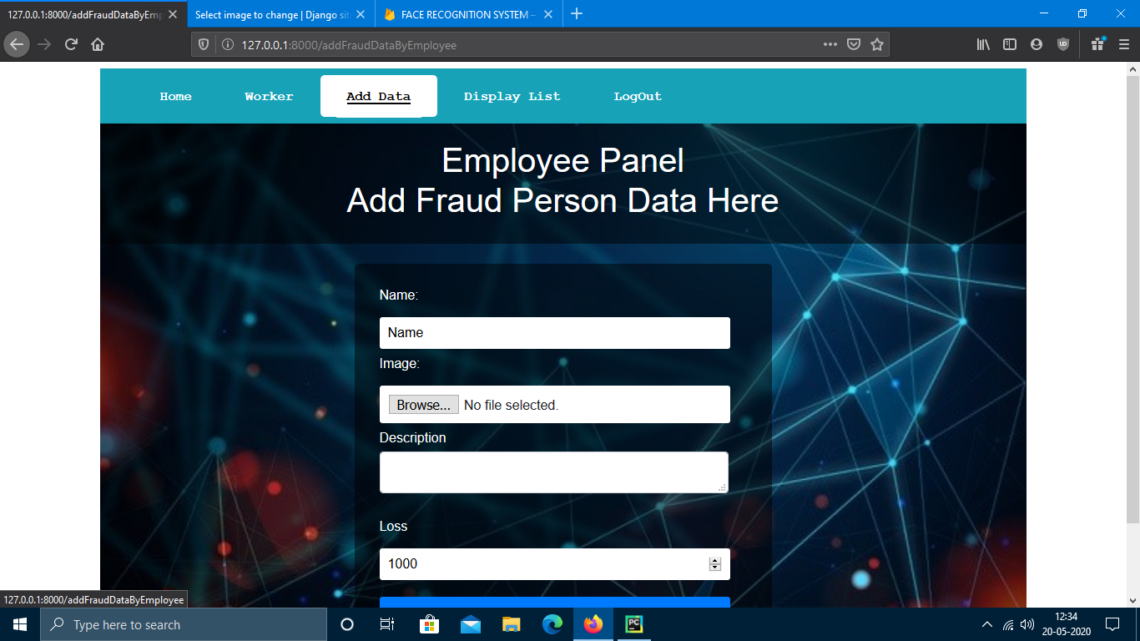
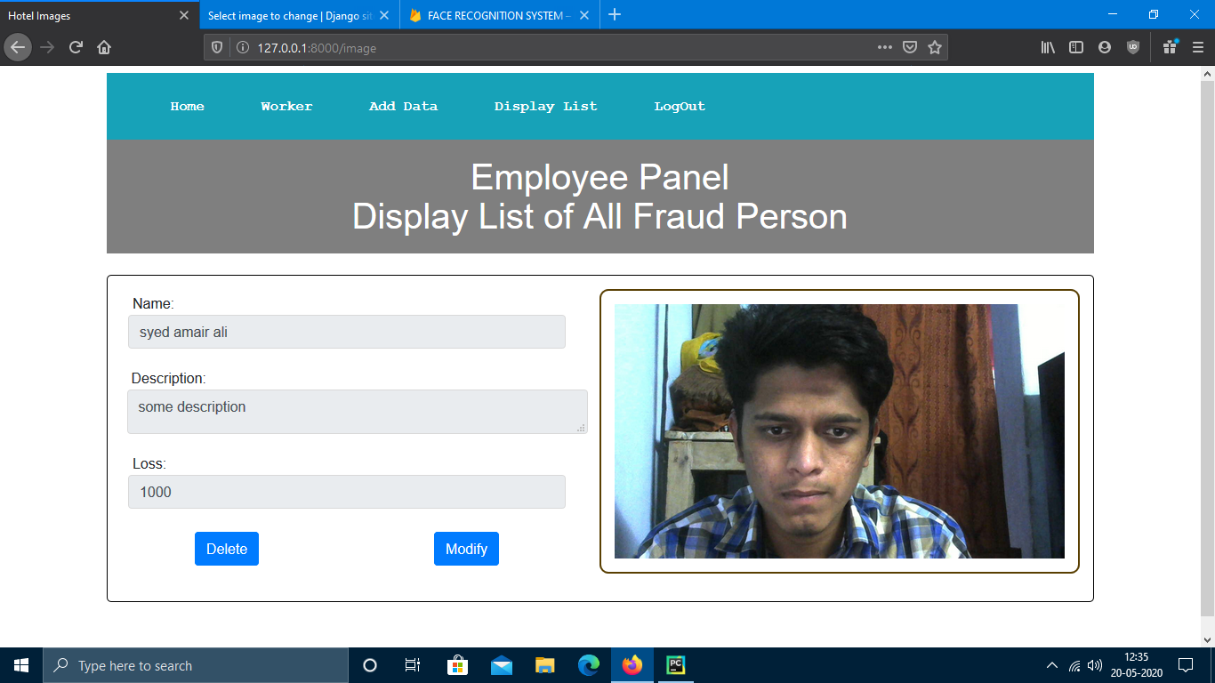
Adding Fraud person By Employee .Displaying data for Employee

Slide 36
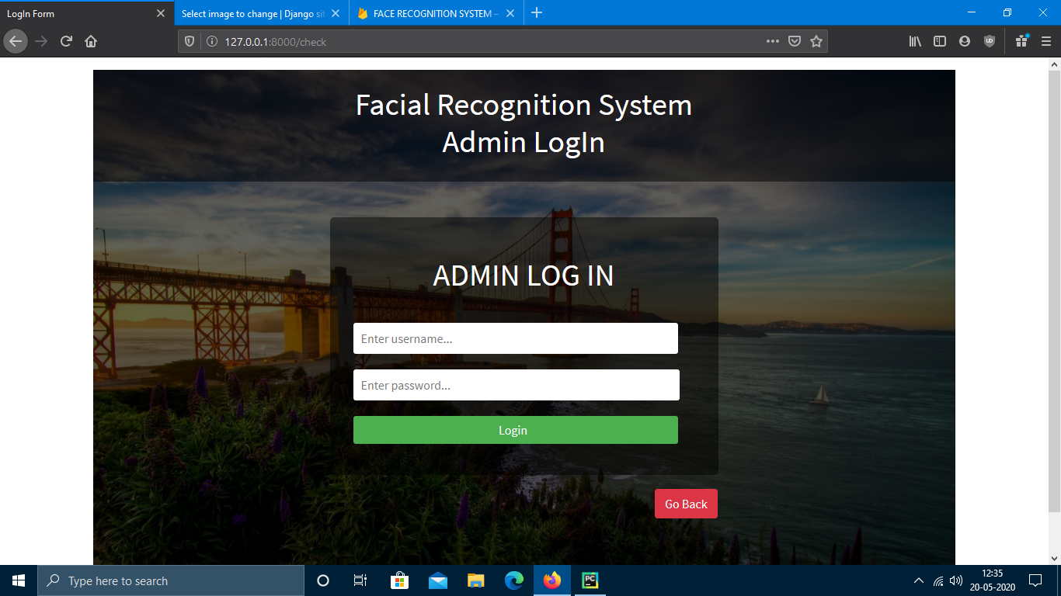
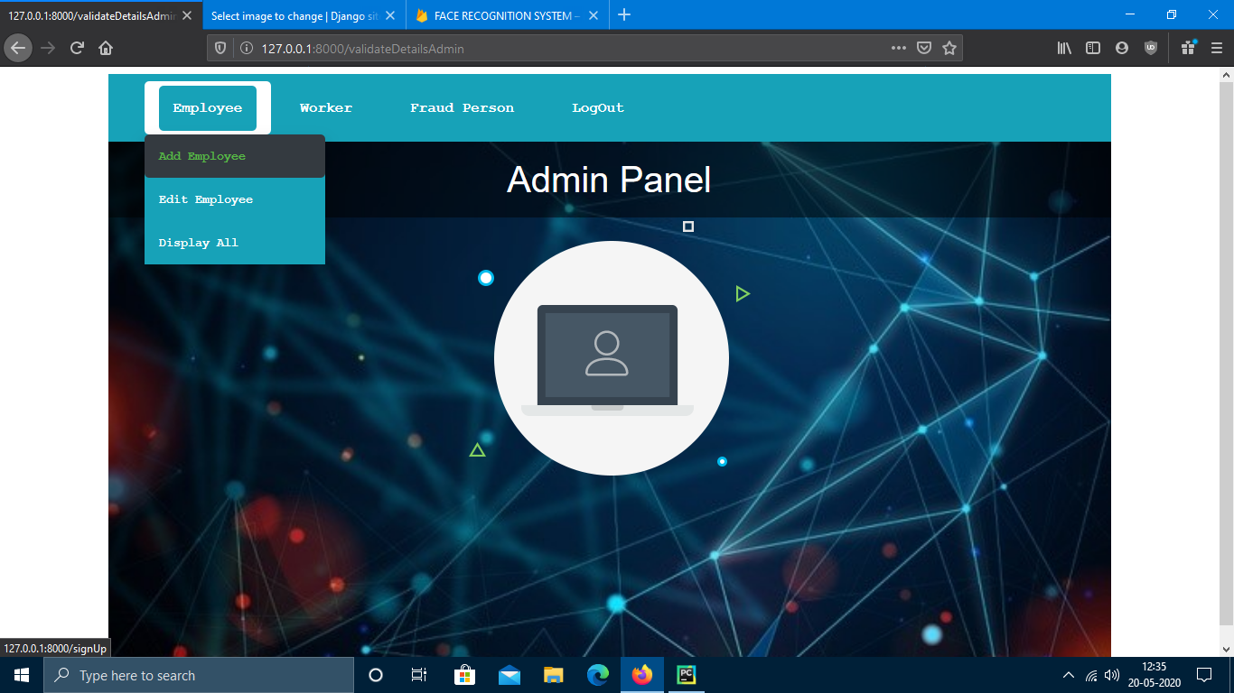
Login Page for Admin .Home page for Admin

Slide 37

Searching Worker page for Admin

Slide 38


results
Face detection
Face detection

Slide 39
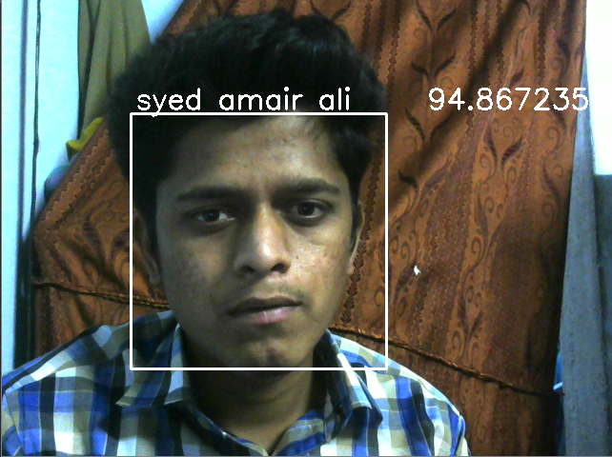

results
Face Recognition
Face Recognition

Slide 40
Conclusion
A face recognition system must be able to recognize a face in many different imaging situations.
It will find faces efficiently without exhaustively searching the image.
Face recognition systems are going to have widespread application in smart environments.

Slide 41
References
https://towardsdatascience.com/face-detection-for-beginners-e58e8f21aad9
https://deepai.org/machine-learning-glossary-and-terms/feature-extraction
https://towardsdatascience.com/face-recognition-for-beginners-a7a9bd5eb5c2
https://towardsdatascience.com/one-shot-learning-with-siamese-networks-using-keras-17f34e75bb3d
https://towardsdatascience.com/a-comprehensive-hands-on-guide-to-transfer-learning-with-real-world-applications-in-deep-learning-212bf3b2f27a
https://towardsdatascience.com/mtcnn-face-detection-cdcb20448ce0
https://pusher.com/tutorials/push-notifications-android

Slide 42


